Slide 1
Sales Forecast Analytics
Capstone
project Group 4
DATA SCIENCE PRODEGREE PROJECT WITH kPMG

Slide 2
mentor
Group 4
Team
Rahul Gopi
Praveen Naidu
Mayur Sharma
Nikhil hattaraki
Dr. divyanshu sinha (KPMG)

Slide 3
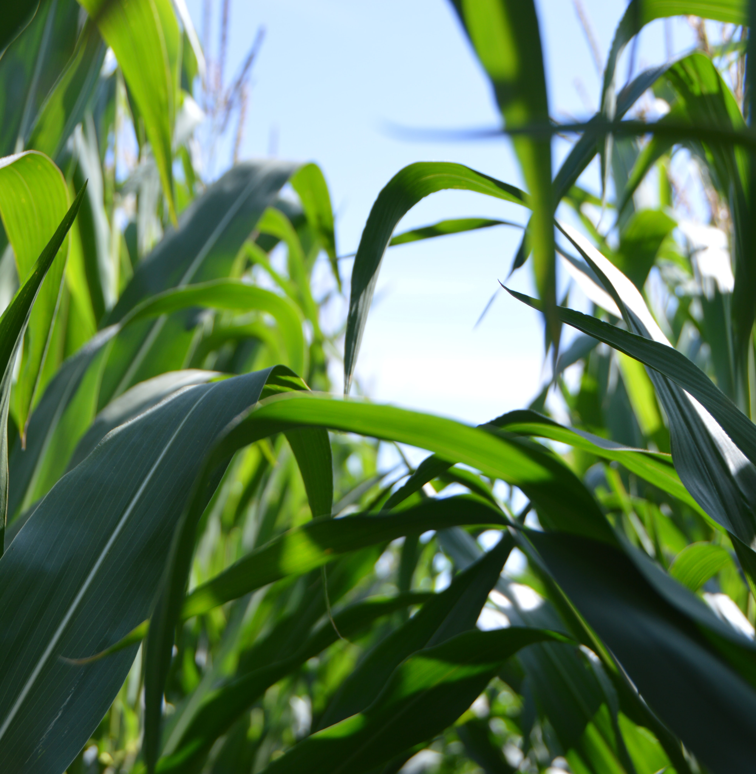

SUMMARY
In this project, we have analyzed and forecasted sales of pesticides for a domestic pesticide manufacturing company and analyzed variables that could impact the sales of the product.

Slide 4
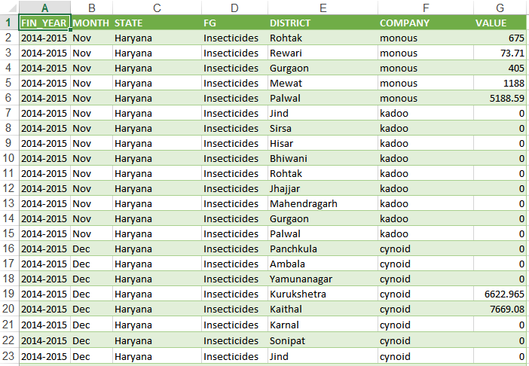
DATA
FIN_YEAR
MONTH
STATE
FG
DISTRICT
COMPANY
VALUE

Slide 5







Data Dictionary
Financial Year
Month of Sale
State of India
Sale Quantity (In tonnes)
.
Pesticide Type
Company Name
District of State

Slide 6



Objectives
To provide state wise forecast of Pesticide sales for ABC Manufacturing.
To conduct state wise trend analysis of the given sales.
To identify other reasons if they are influencing Pesticide sales

Slide 7
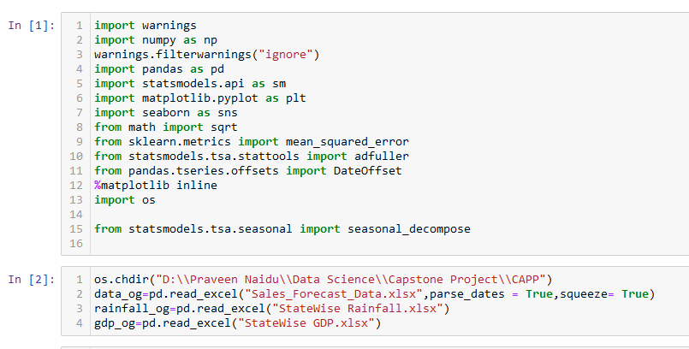
IMPORTING LIBRARIES & dATA

Slide 8
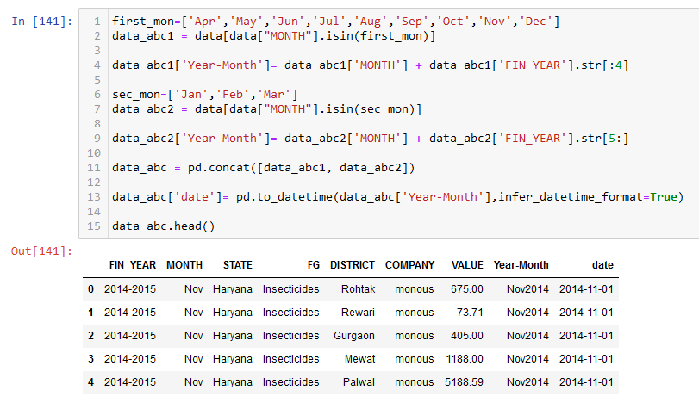
exploratory data analysis

Slide 9
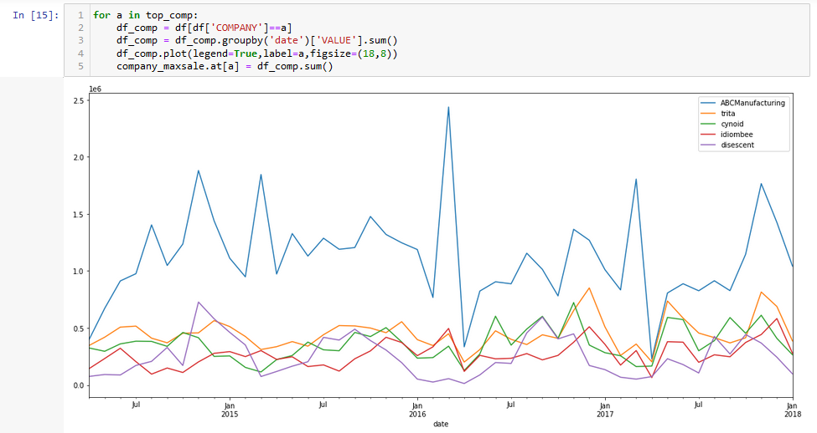
ABC COMPANY VS OTHER TOP PERFORMING COMPANIES

Slide 10
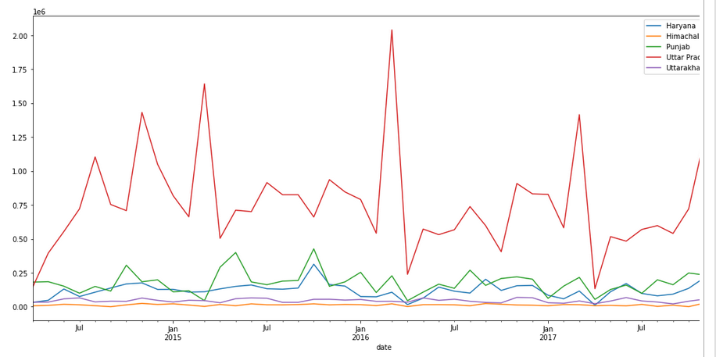
STATE WISE SALES OF ABC COMPANY

Slide 11
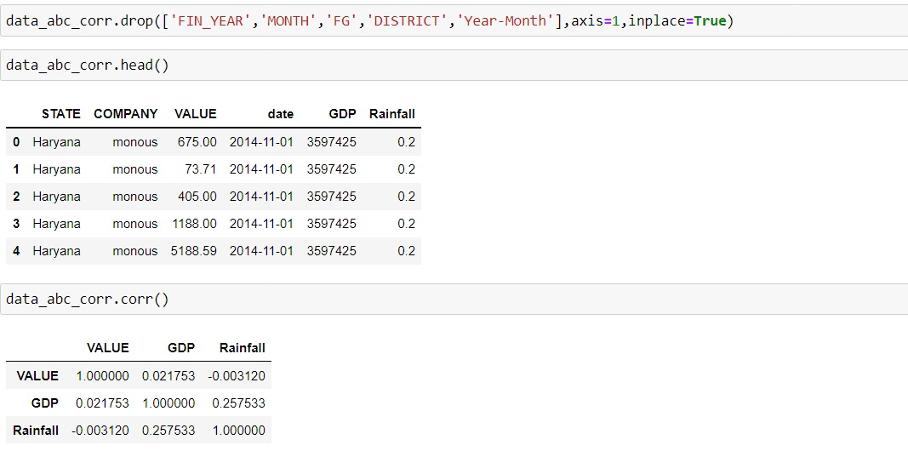
CORRELATION MATRIX

Slide 12
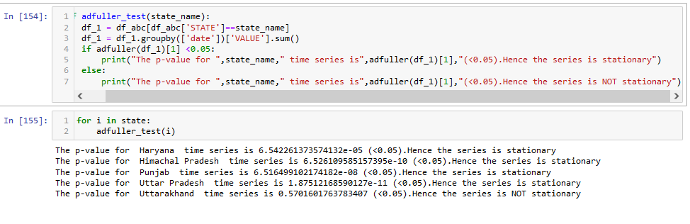
STATIONARITY CHECK USING ADFULLER TEST

Slide 13
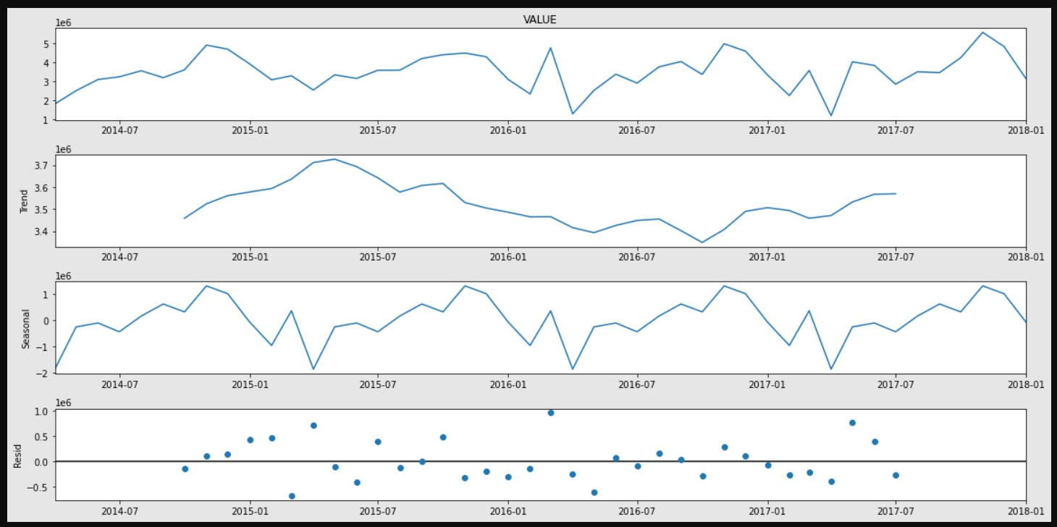
SEASONALITY CHECK AFTER DECOMPOSITION

Slide 14
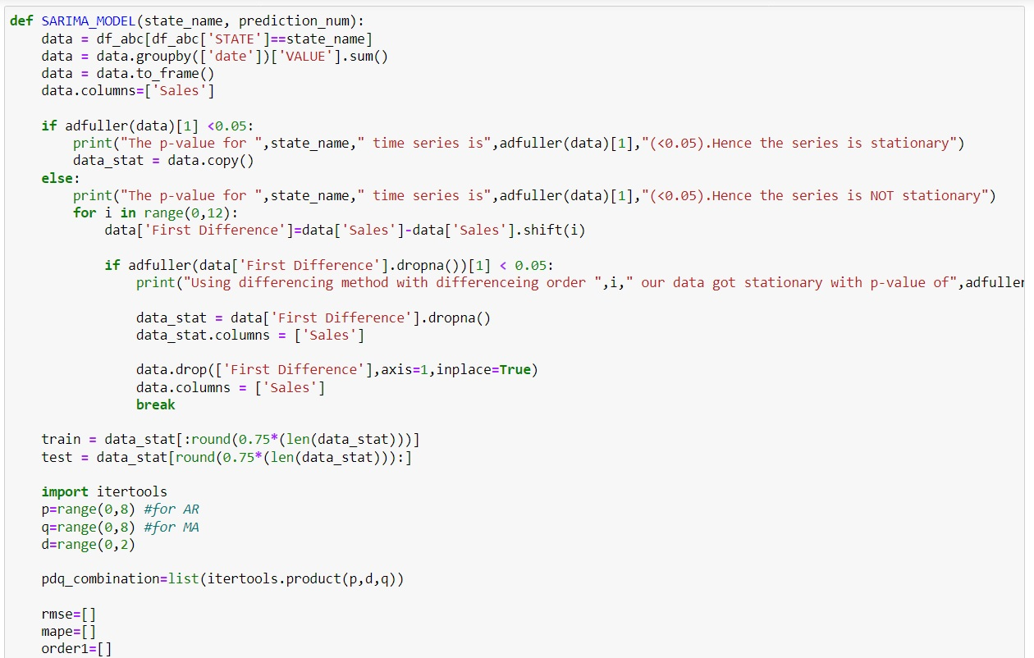
TIME SERIES ANALYSIS USING SARIMA MODEL

Slide 15
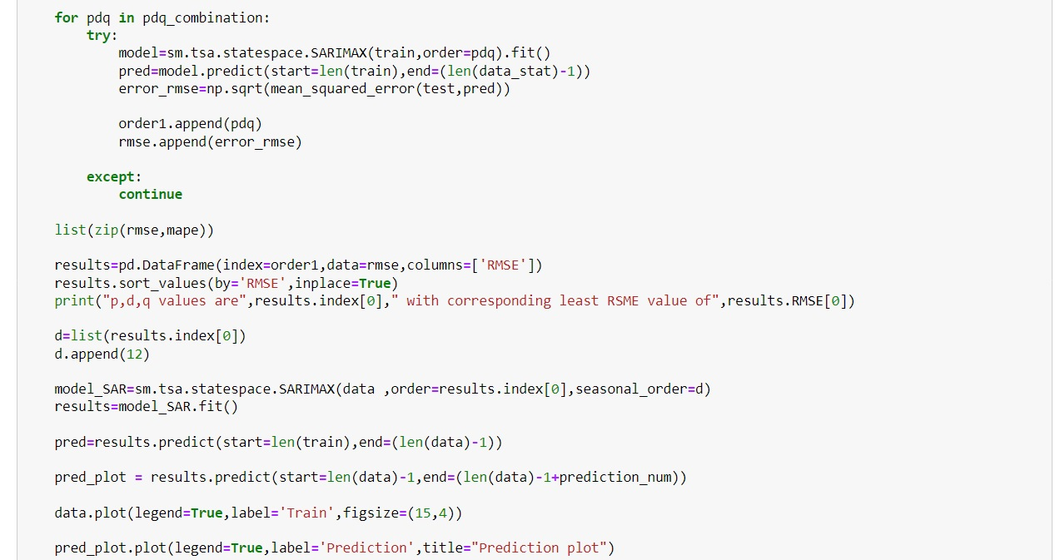
TIME SERIES ANALYSIS USING SARIMA MODEL

Slide 16
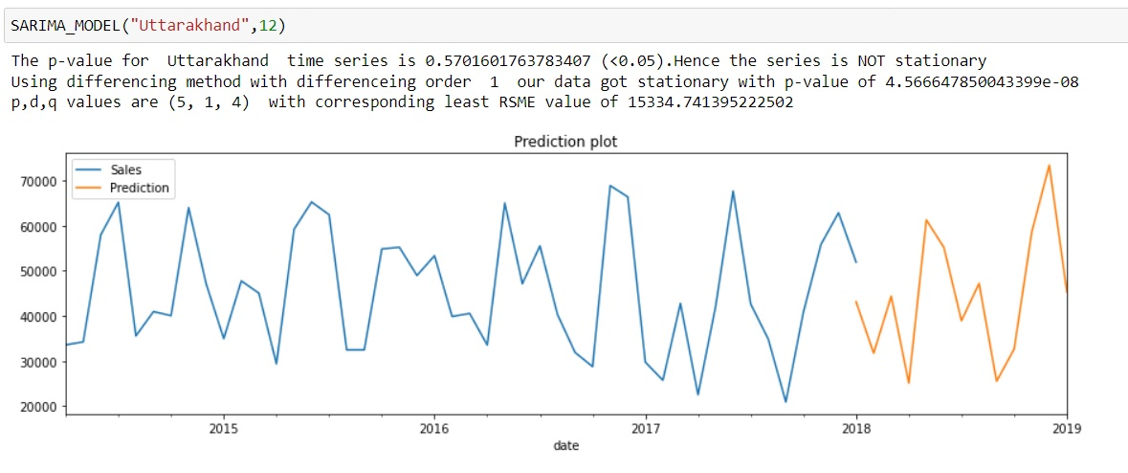
FORECASTING SALES FOR UTTARAKHAND

Slide 17
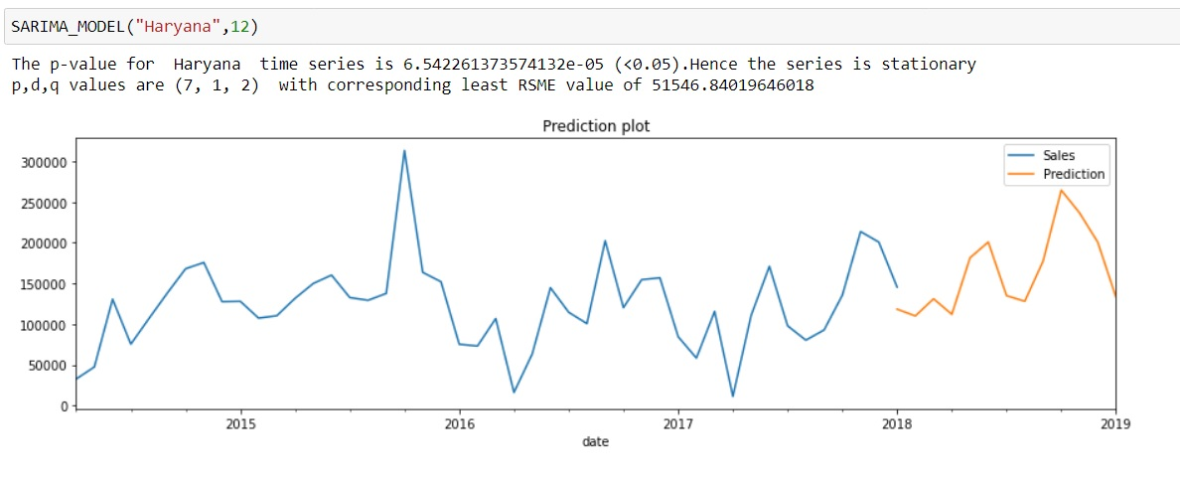
FORECASTING SALES FOR HARYANA

Slide 18
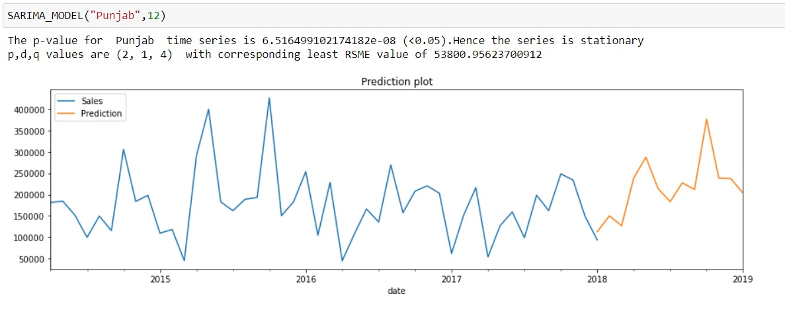
FORECASTING SALES FOR PUNJAB

Slide 19
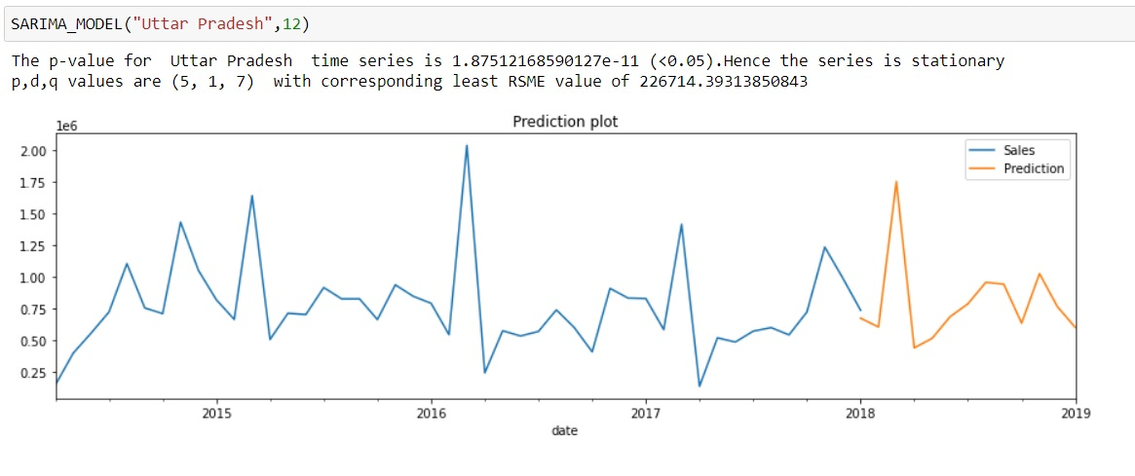
FORECASTING SALES FOR UTTAR PRADESH

Slide 20
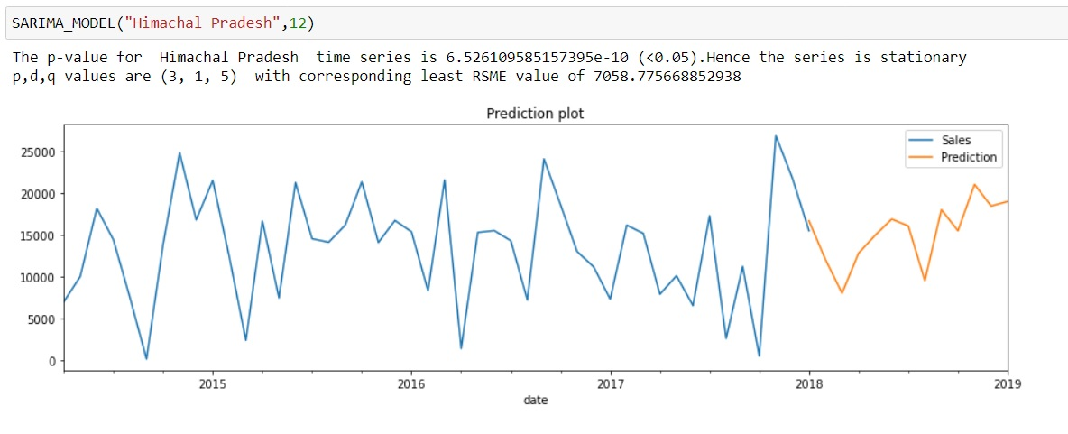
FORECASTING SALES FOR HIMACHAL PRADESH

Slide 21
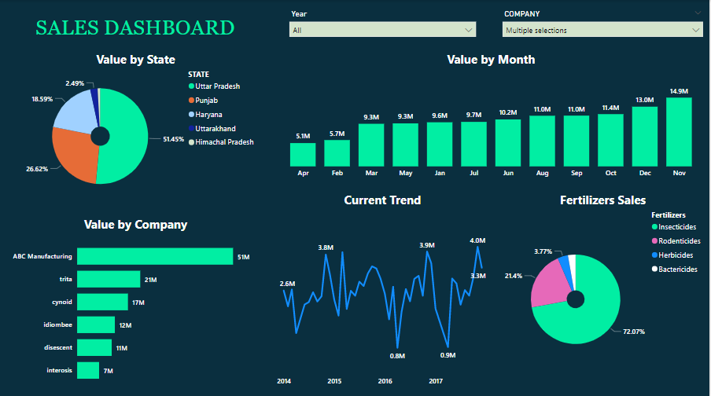
POWER BI DASBOARD

Slide 22
references
Rainfall Data: INDIA METEOROLOGICAL DEPARTMENT (MINIS TRY OF EARTH SCIENCES)
https://mausam.imd.gov.in/imd_latest/contents/rainfallinformation.php
Agricultural GDP Data: Reserve Bank of India
https://www.rbi.org.in/Scripts/AnnualPublications.aspx?head=Handbook+of+Statistics+on+Indian+States

Slide 23


Thank You

